Slide 1

Heart Failure Prediction
David Addo

Slide 2
Heart disease failure
Overview
Data Introduction & Description
Visualizations
Graphs depicting findings of interest to Heart Failure Predictions
Models
Three models were used and Evaluated
Strengths & Limitations
Brief Analysis of strengths and weaknesses of each model
Recommendations
Final model selection and recommendation based on Analysis

Slide 3
Data overview
CVD : #1 Cause of death globally. 17.9 lives each year
4 out of 5 CVDs are due to Heart attacks and strokes. 1/3 occur in people under Age 70
Heart failure is a common even caused by CVDs
12 attributes related to CVDs identified to possibly predict Heart Disease.
Early detection and management of CVDs or a high risk can be vital in saving lives
Machine Learning models can be of great help in prediction existing or high risk of CVDs

Slide 4
visualizations
ST Depression vs Heart Disease
Sex vs Heart Disease
Age vs Heart Disease

Slide 5
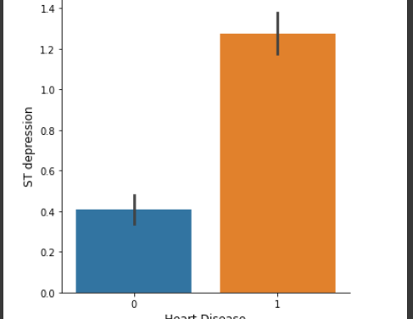
ST DEPRESSION VS HEART DISEASE
Heart Disease = above 1.2
No Heart Disease = 0.4

Slide 6
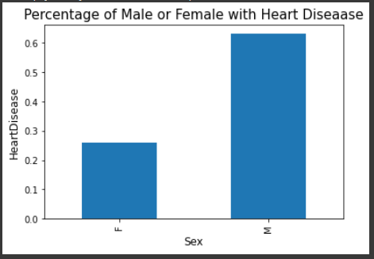
Sex vs heart disease
Male = about 64%
Female = about 26%
Note: There were more male samples(725) in the dataset(918)

Slide 7
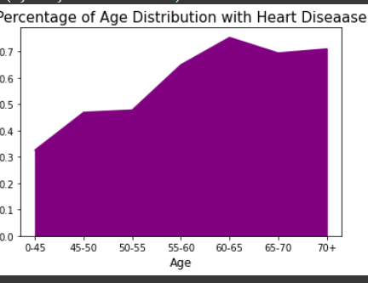
Age vs heart disease
Increases with Age
Over 45 more risk

Slide 8

Models

Slide 9
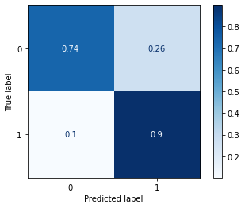
Model 1 strengths & limitations
False Positive = 26%
False Negative = 10%
True Positive = 90%
Tue Negative = 74%

Slide 10
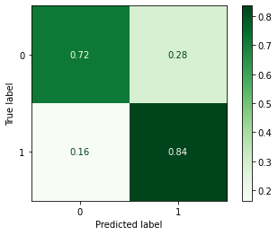
Model 2 strengths & limitations
False Positive = 28%
False Negative = 16%
True Positive = 84%
Tue Negative = 72%

Slide 11
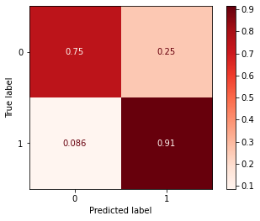
Model 3 strengths & limitations
False Positive = 25%
False Negative = 9%
True Positive = 91%
Tue Negative = 75%

Slide 12
Final model: Model 3

Slide 13
Final model cont’d
The best model with the best results in predicting false negatives is the final random forest model which has a false negative prediction of 9%. This model may be useful in production, but I think 9% is still a high percentage of false negatives and is material to the quality of results you want to provide to patients as it can be life threatening.

Slide 14
Recommendations
The concern raised about the final model's prediction can, however, be reduced by adding more data to train the model to possibly get the prediction results lower than 5% .
Adding some more features or removing some of the attributes after talking to a subject matter expert is also another recommendation.

